Slide 1
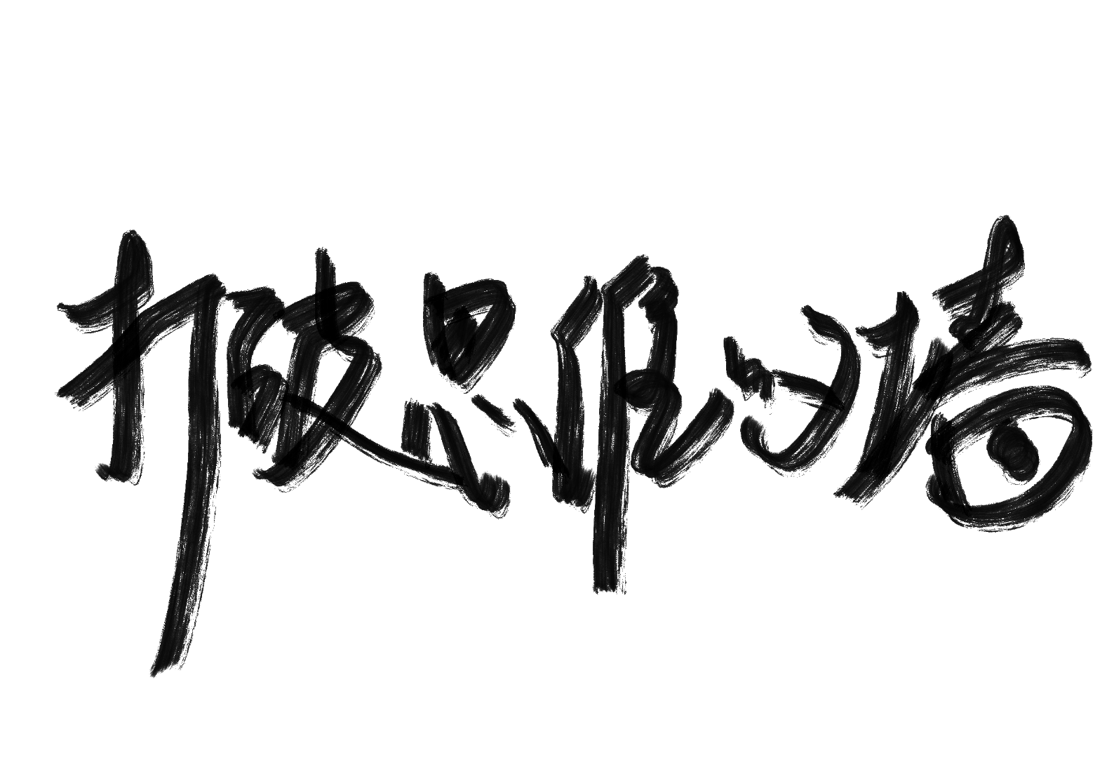
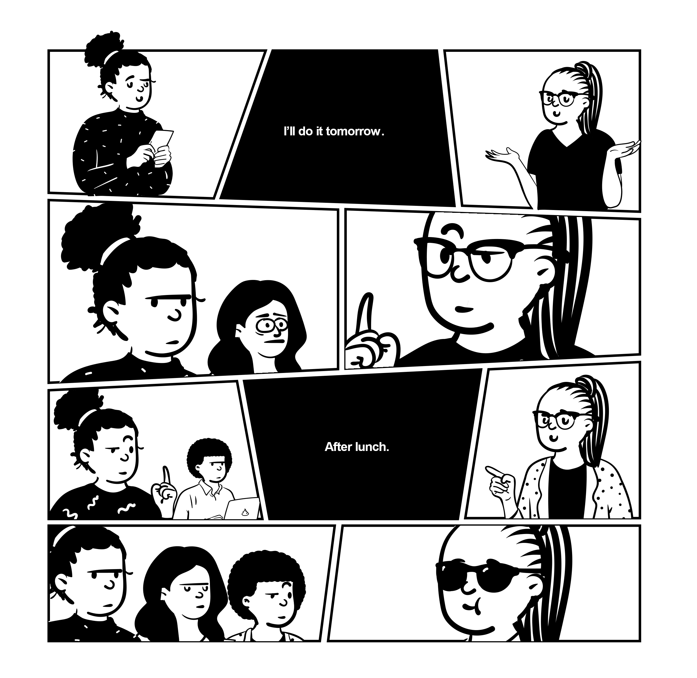
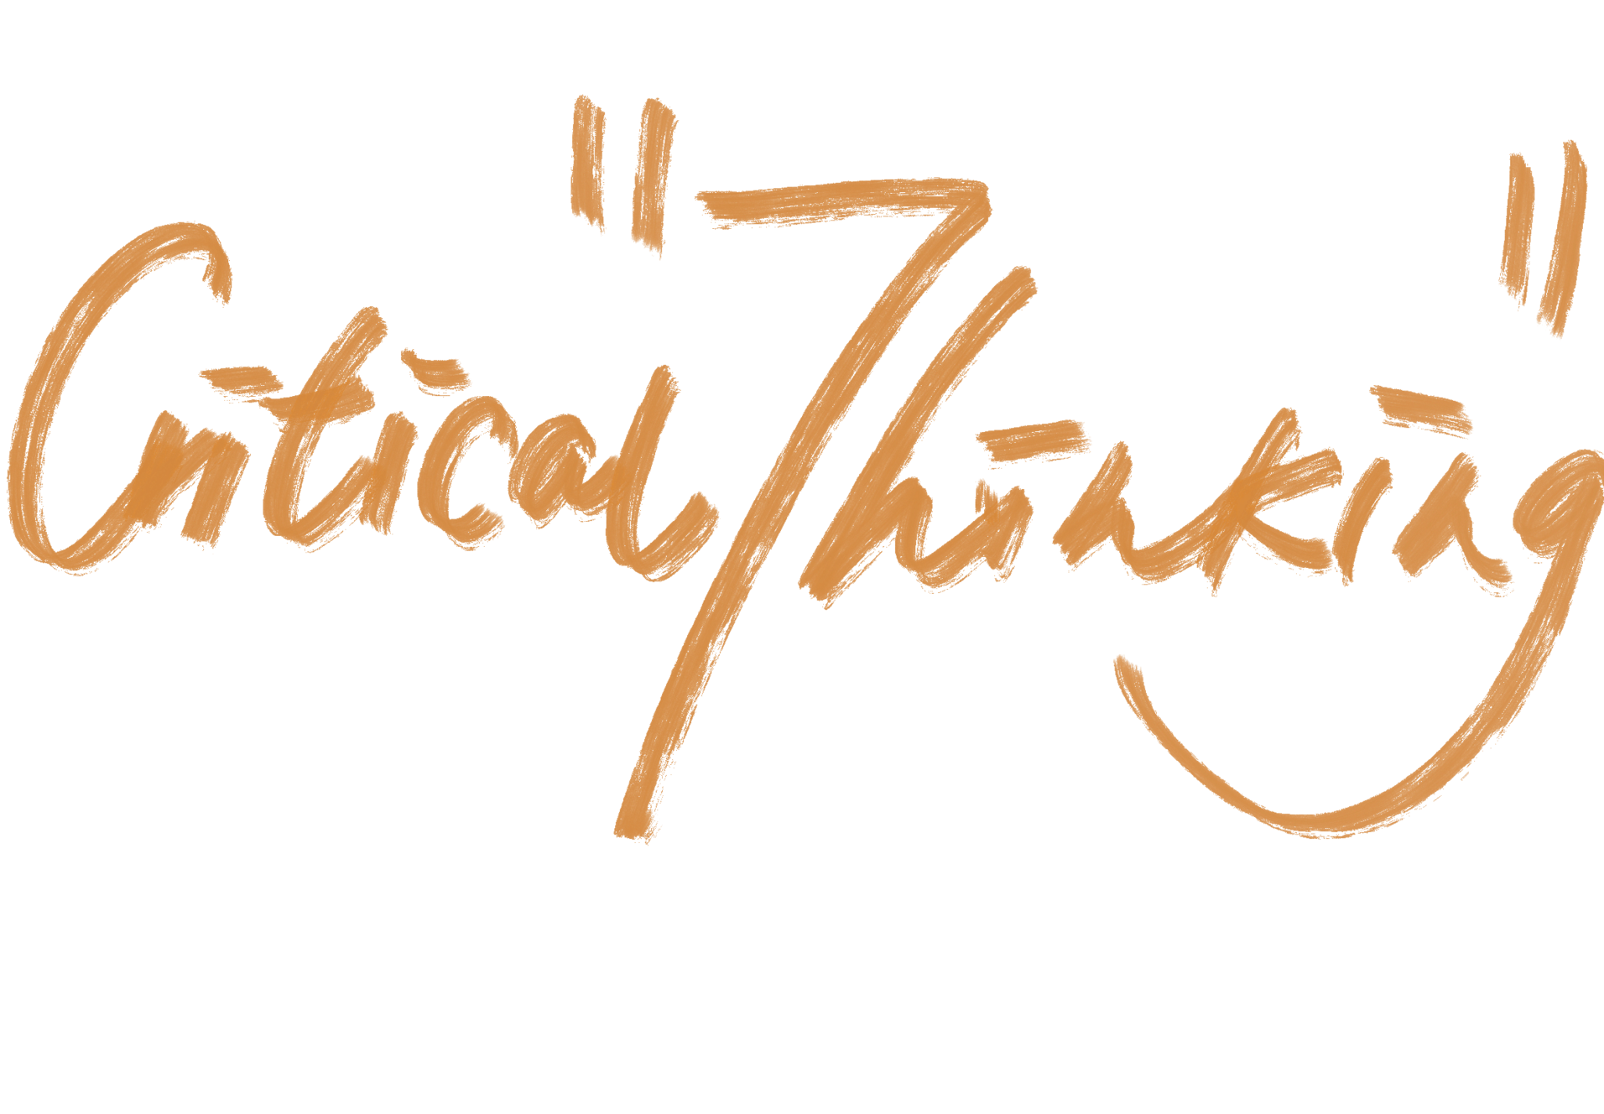
Member:柯嘉瑜、梁高敏、李思杭、李行、黄钰芝

Slide 2
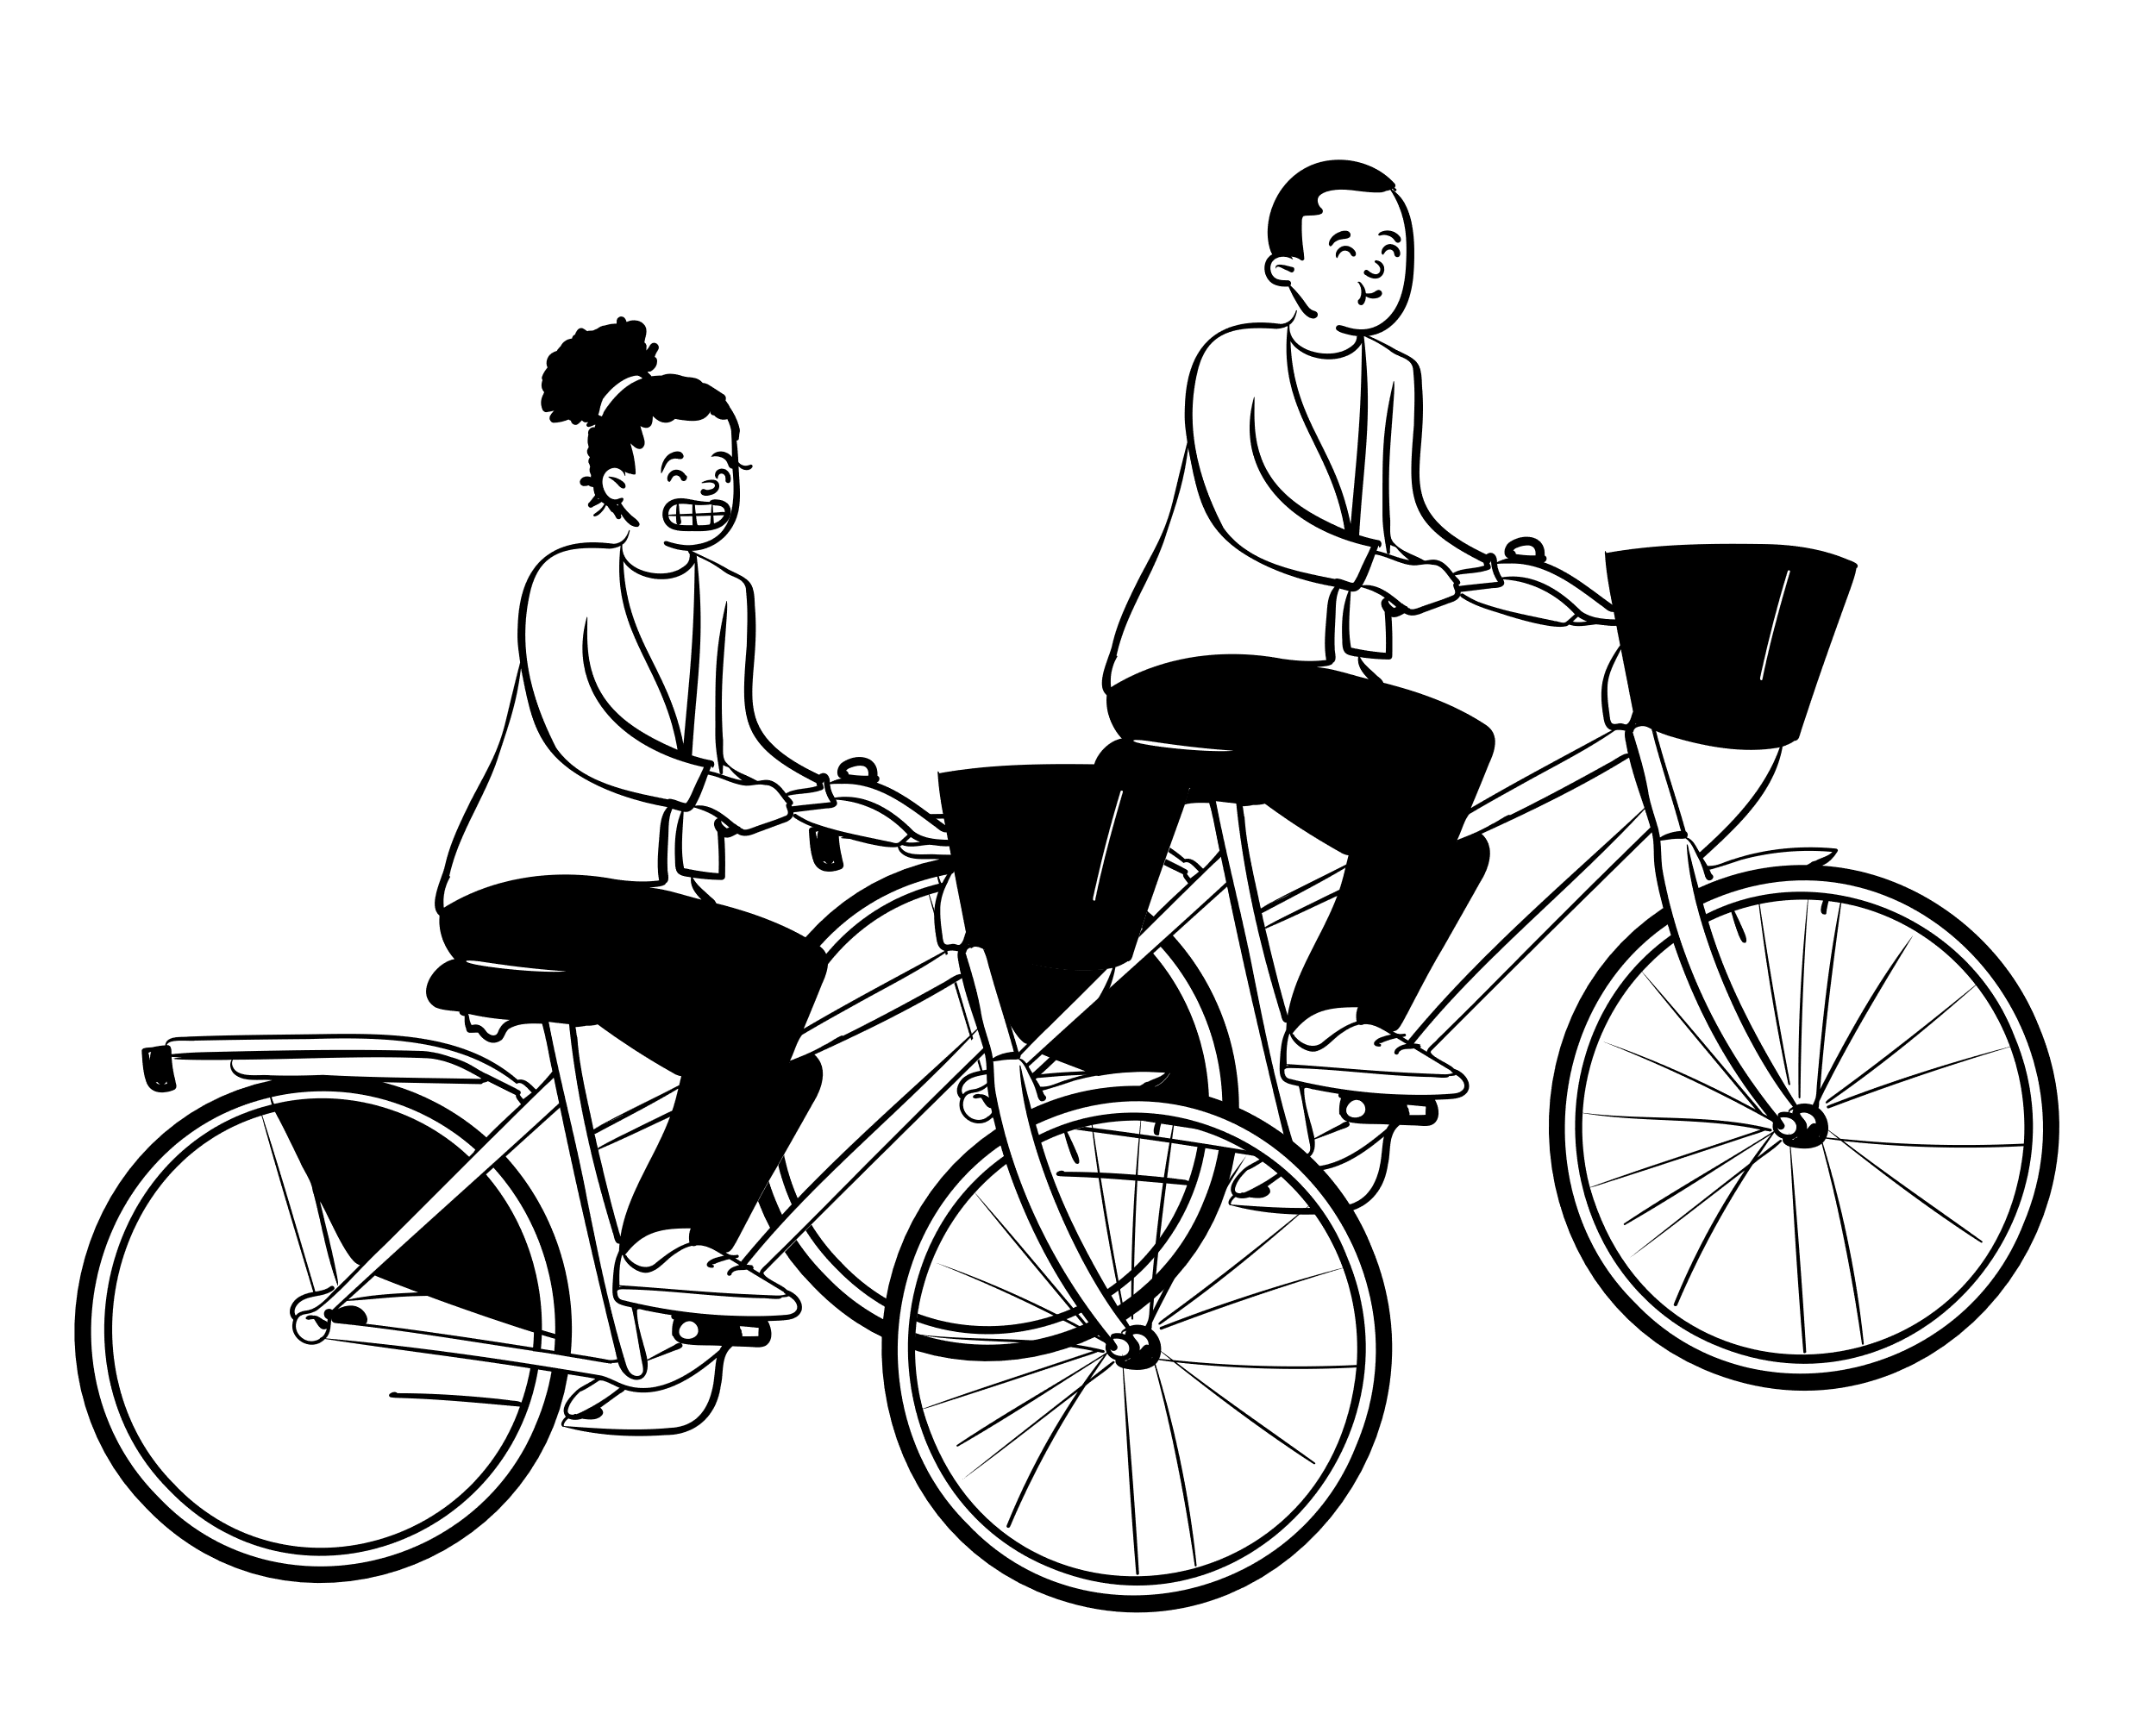
critical thinking
what is
Critical Thinking?
the process of thinking carefully about a subject or idea, without allowing feelings or opinions to affect you.
——Cambridge dictionary

Slide 3
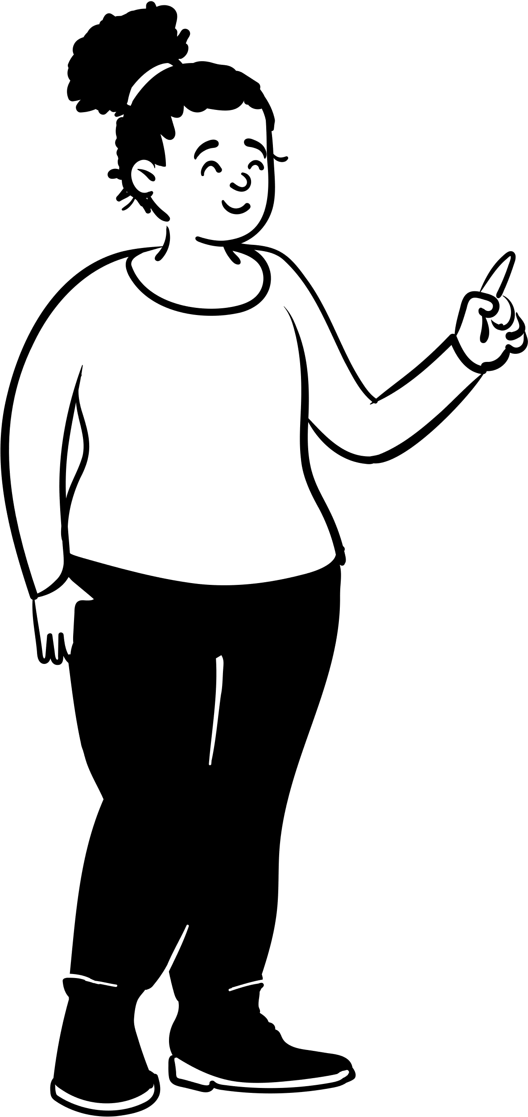
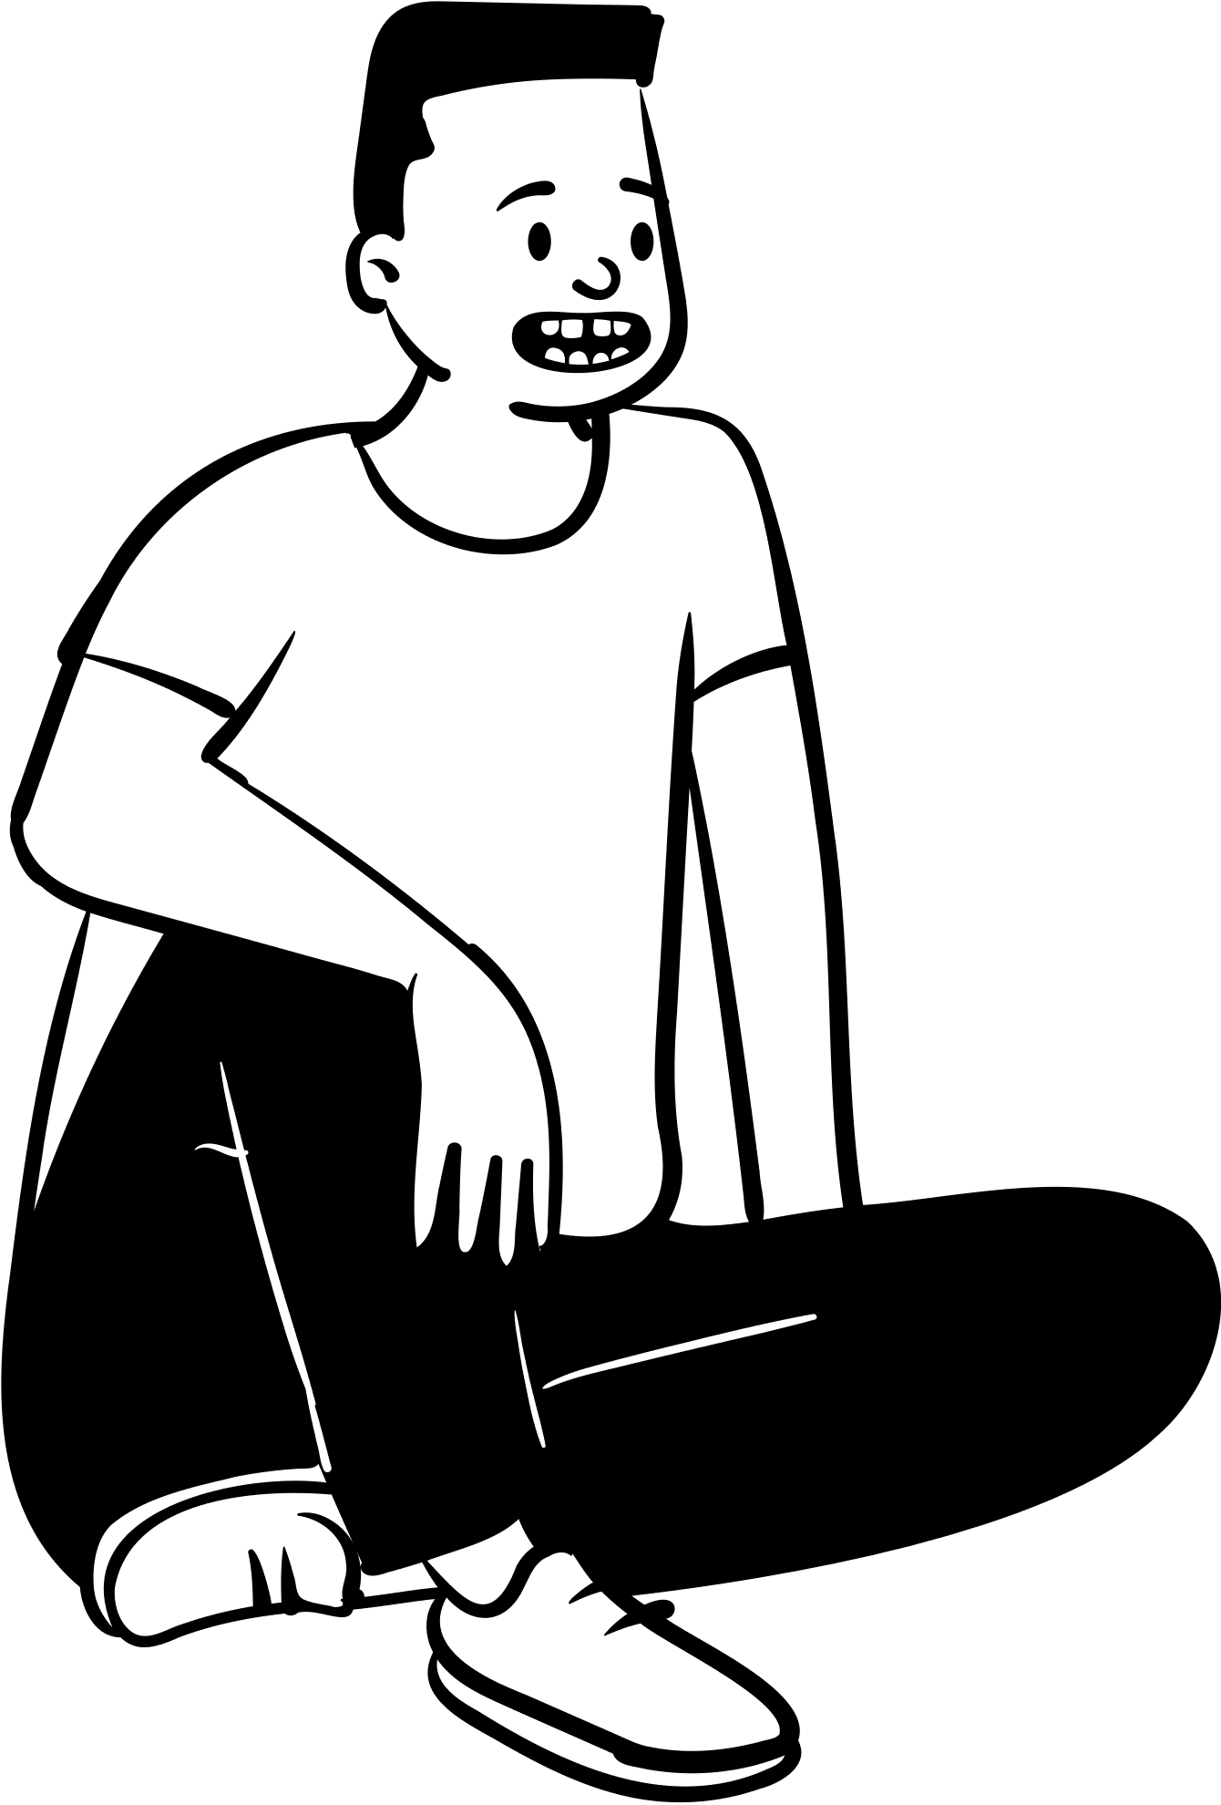
1.slippery slope
2.straw man fallacy
3.circular reasoning
4.beggar logic
some common logical fallacies

Slide 4
No good elementary school
No good middle school
No good high school
slippery slope
滑坡谬误
Ⅰ
No good university
No excellent graduate studies
No good job
Life failure

Slide 5
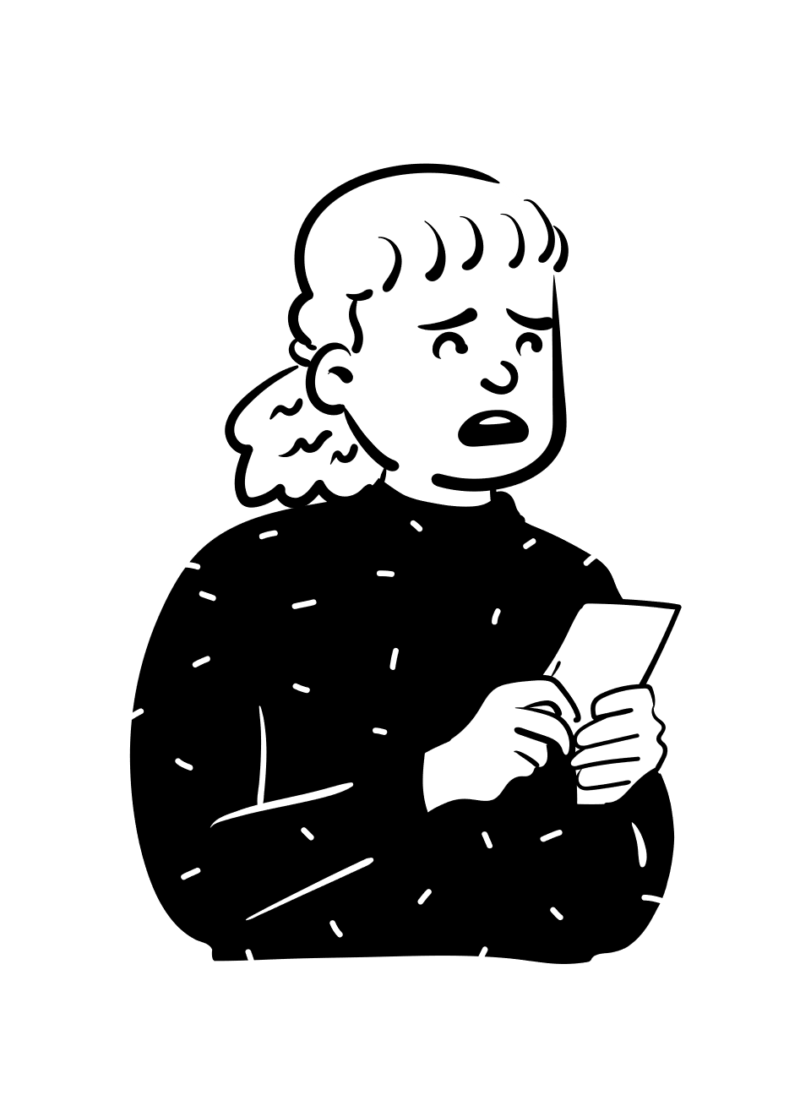
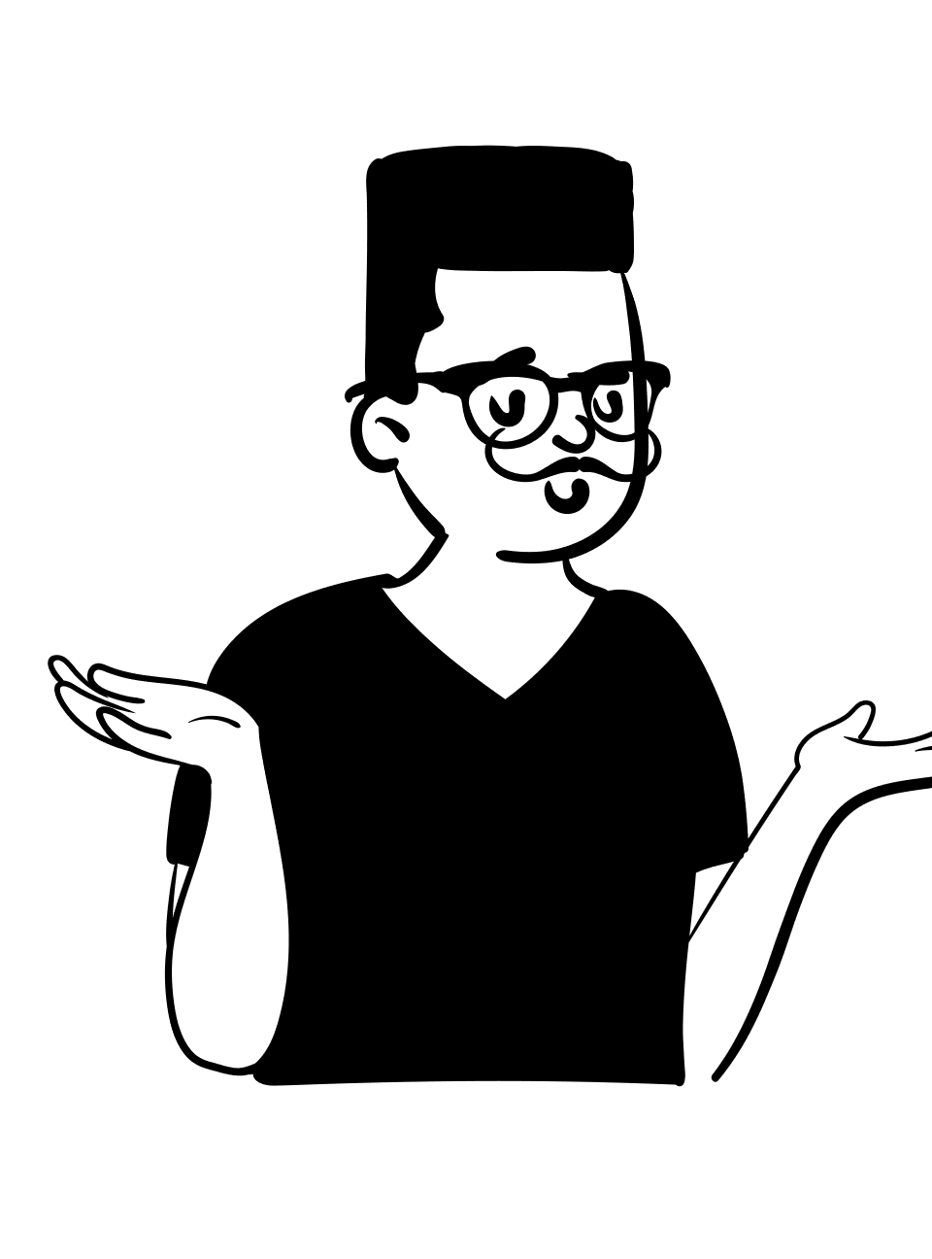
You don't use Huawei phone, you are not patriotic.
Ⅱ
Straw man
  稻草人谬误
You like Japanese stars. You're not patriotic.

Slide 6

You shouldn't lie even to protect your friends who are threatened by bad guys.
III
circular reasoning
  循环论证
Why shouldn't you lie?
Because lying is immoral.
beggar logic
乞丐逻辑
Why is lying immoral?
Because we shouldn't lie.

Slide 7
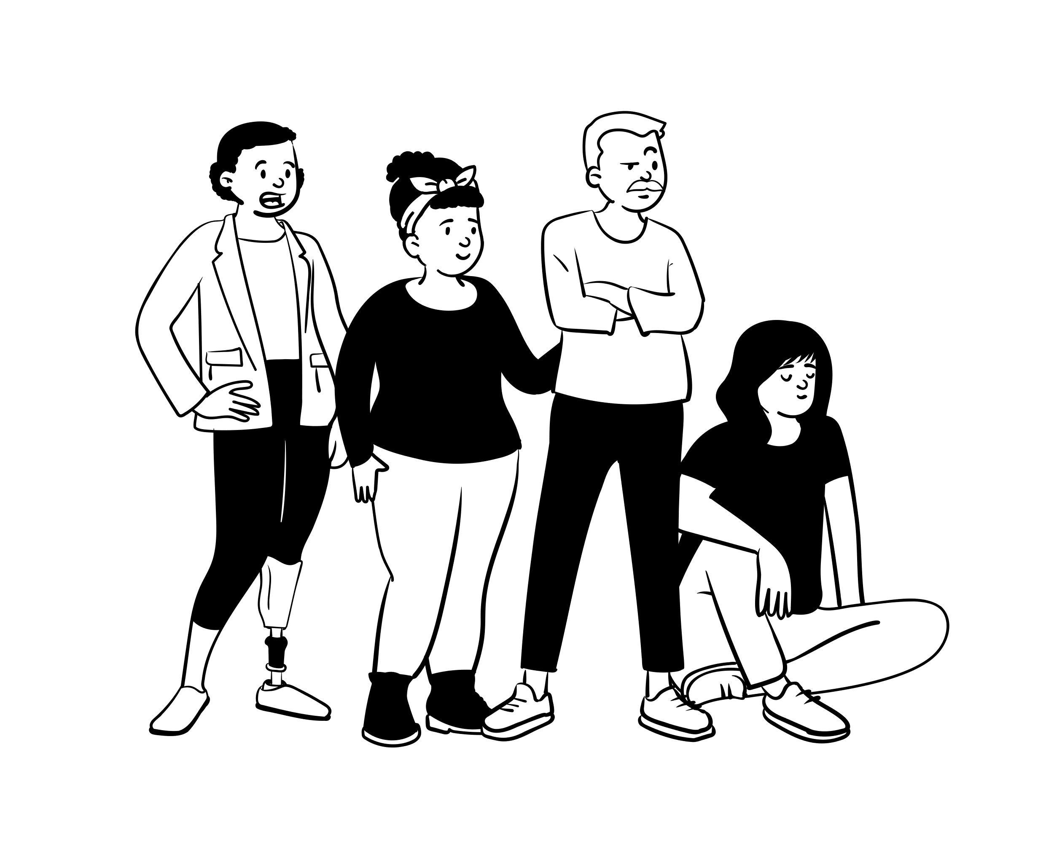
1.formulate the questions
2.gather information
3.apply the information
4.consider the implications
5.explore other’s view
so...
How to think critically?
...

Slide 8
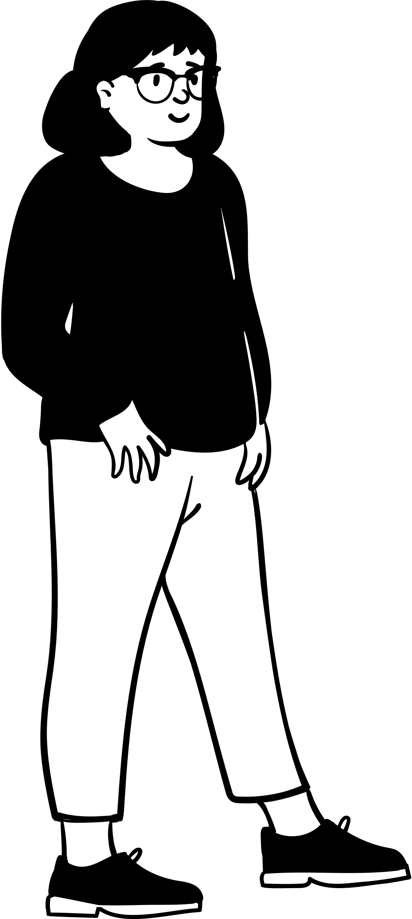
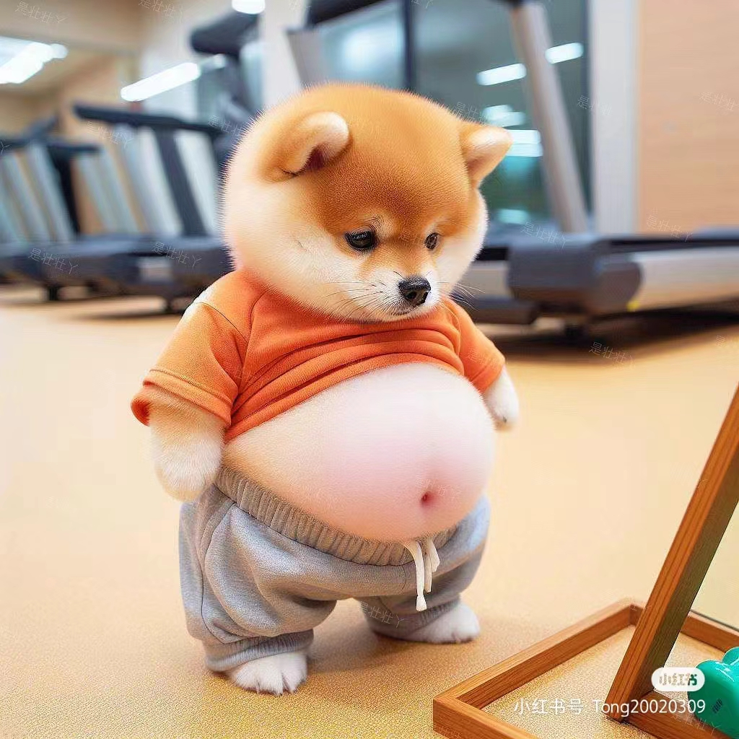
Realistic situation
lose weight
keep healthy
more engery
Mary feels her figure isn't slim enough and wants to lose weight healthily.
First,
formulate the question
So,
what should she do?

Slide 9
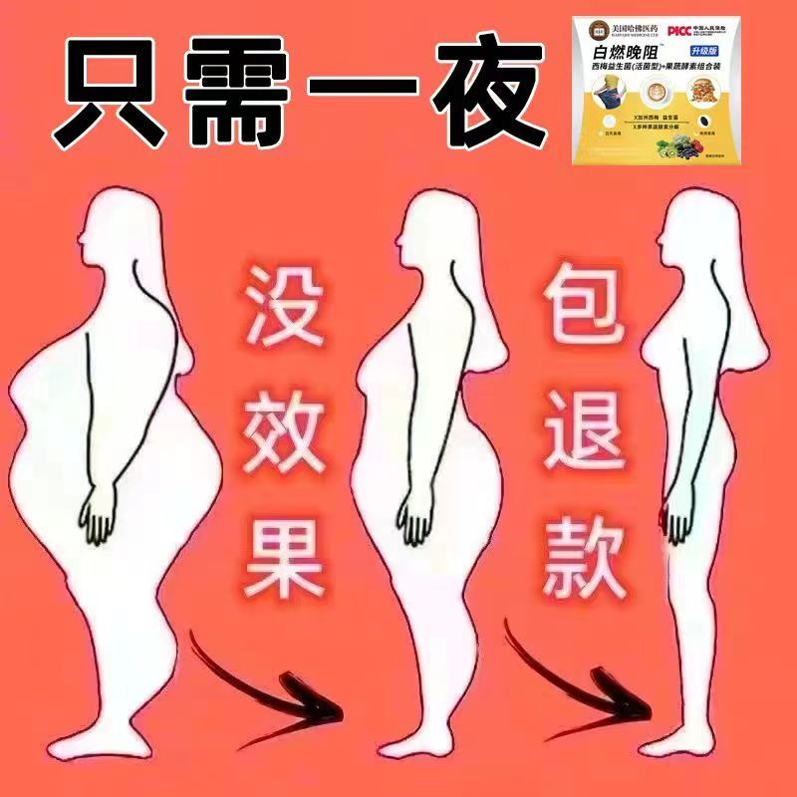


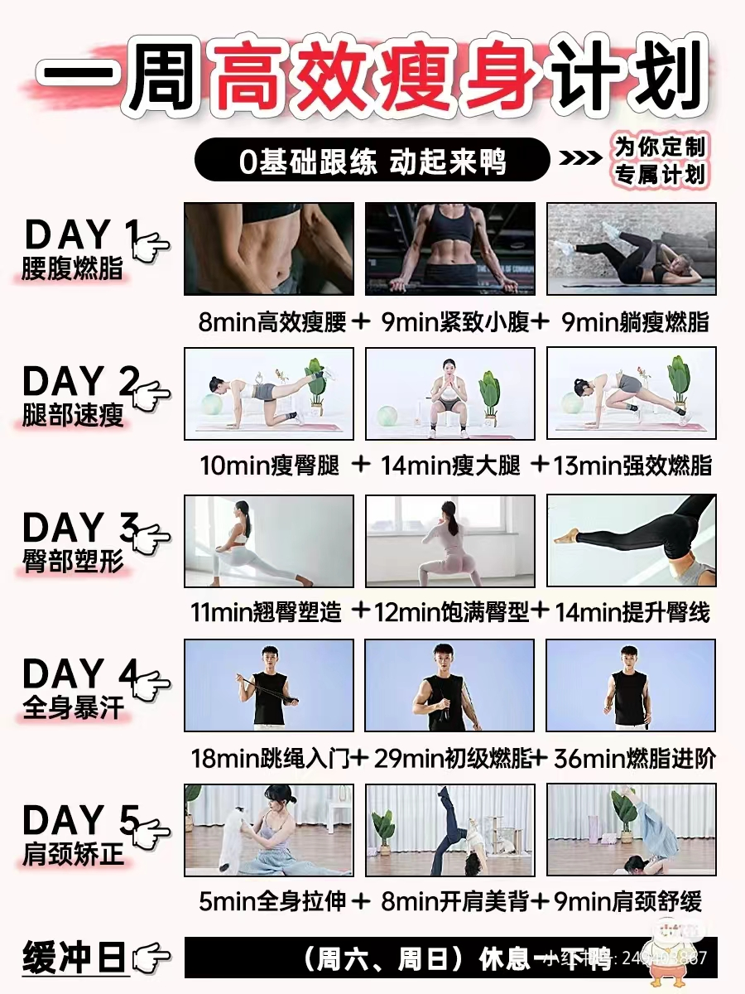
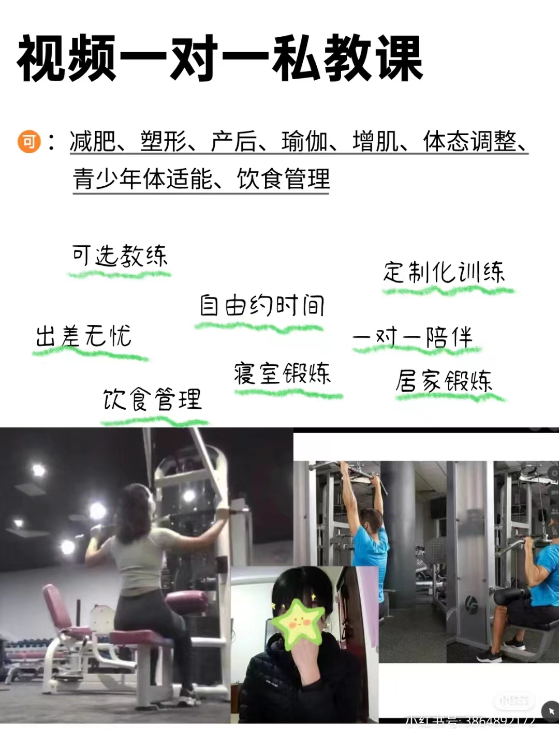
Secondly,
Gather information
·on a diet
ask an expert or seek other’s experience
Secondly,
Gather information
·in sports
what kind of exercise is best for you?
……

Slide 10

Third,
apply the information
is this method scientific?
am i interpreting the information logically?
is the loss goal reasonable?
……
Third,
apply the information
Is that true or not？？？
？？？

Slide 11
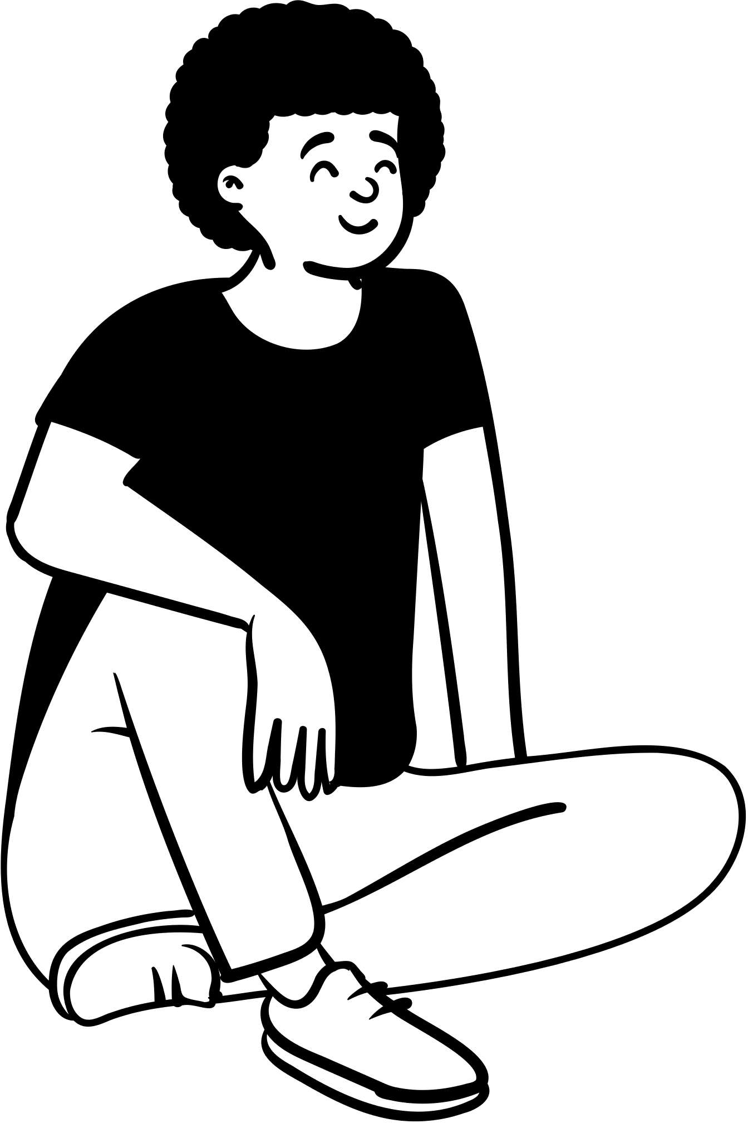
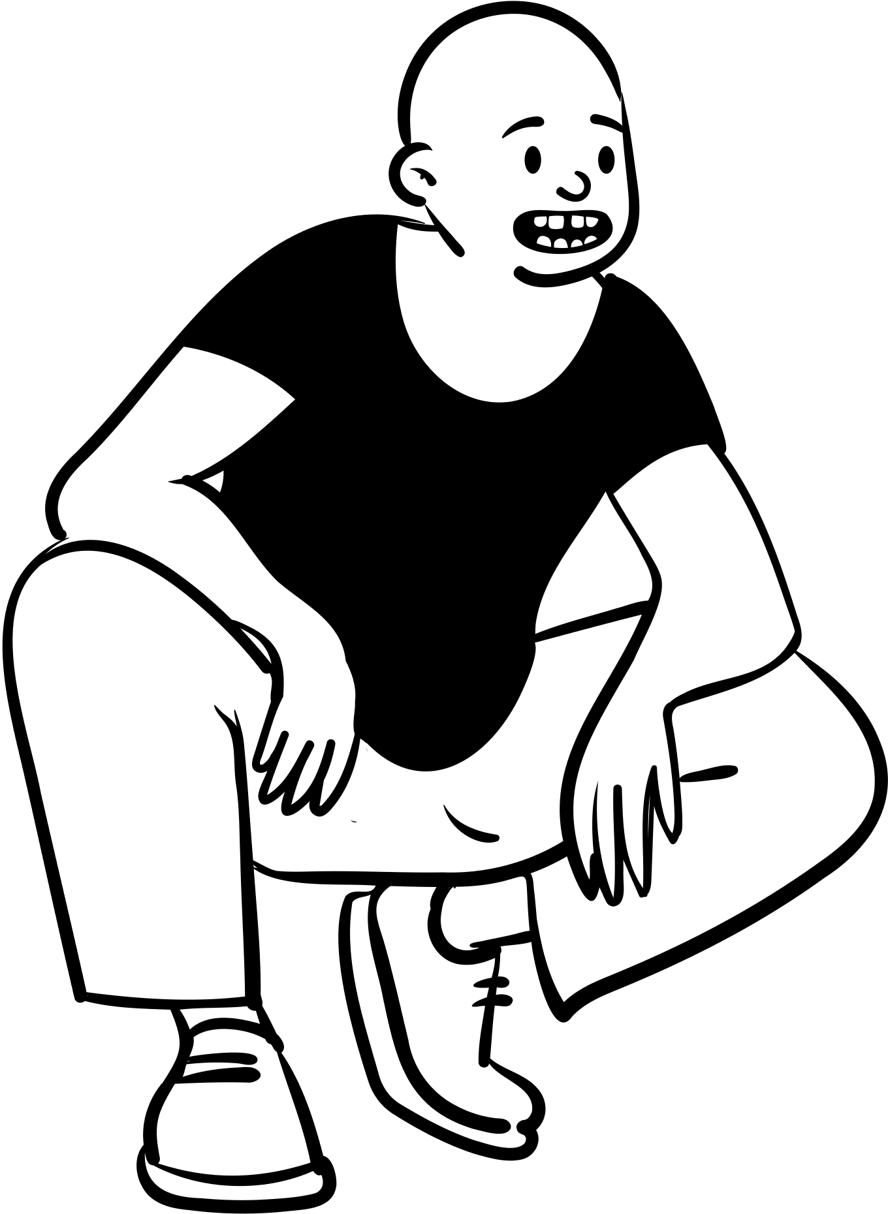
Good?
or bad
for your health?
Then,
consider the implications

Slide 12
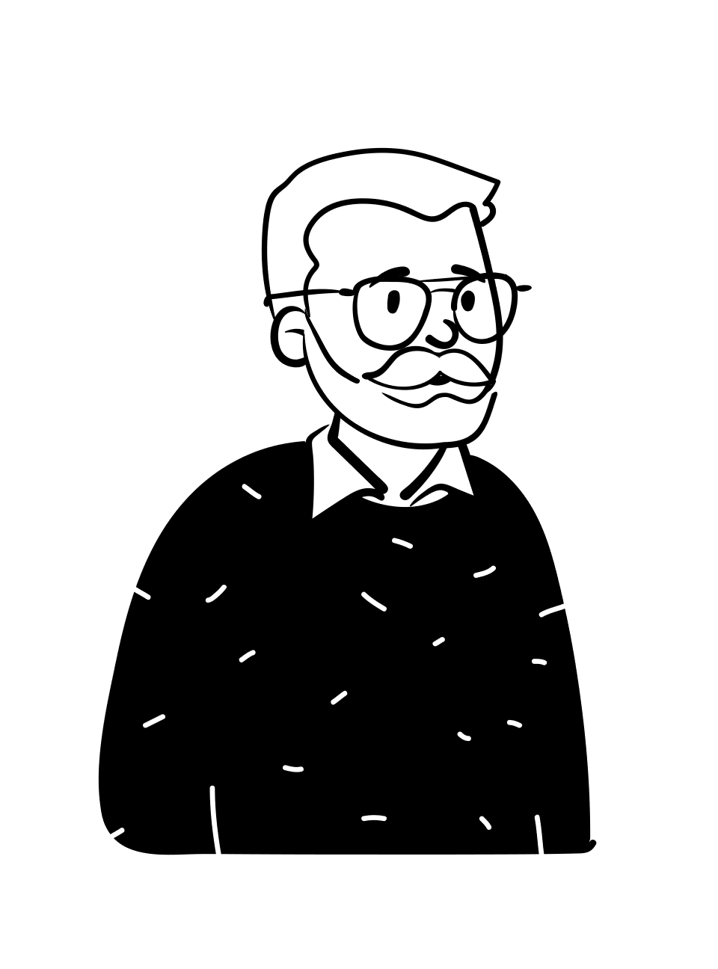
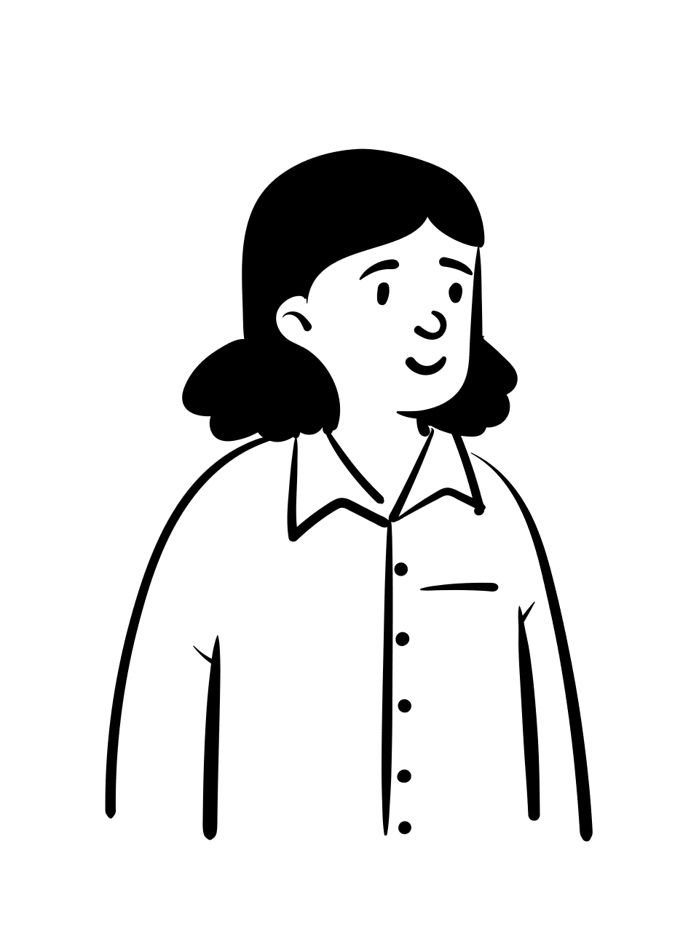
What do you think？
Lastly,
explore other’s viewpoints
In my opinion...

Slide 13
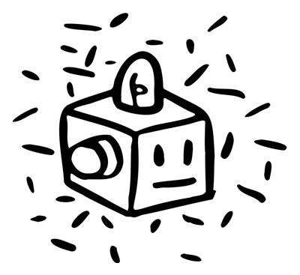
To be a good thinker?
you should first be wary of some common logical fallacies, and secondly, you can refer to the five methods mentioned above to help you think through your problems. Finally, I hope everyone can learn to think.
Summarizing

Slide 14
Thank you!!

